Slide 1
Online Retail store

Slide 2
objective
This case study involves designing and managing a database for an online retail store. The schema includes tables for customers, products, categories, orders, and order details.

Slide 3
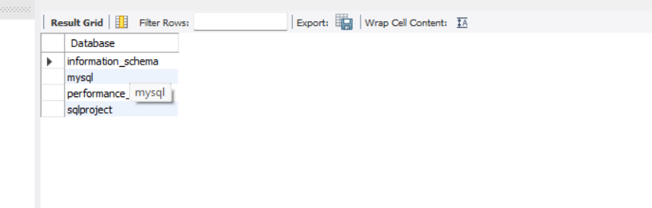
Create database :
Query
create database SQLPROJECT;
Result :

Slide 4
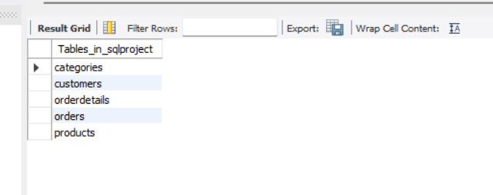
Write SQL statements to create all the tables with the specified columns and foreign key references.
QUERY :-
create table customers ( customerID INT PRIMARY KEY, Name VARCHAR(20), Email VARCHAR(20), RegistrationDate DATE.
CREATE TABLE Products ( ProductID INT PRIMARY KEY, ProductName VARCHAR(200), Price DECIMAL(10, 2), CategoryID INT, FOREIGN KEY (CategoryID) REFERENCES Categories(CategoryID));
CREATE TABLE Categories ( CategoryID INT PRIMARY KEY, CategoryName VARCHAR(30));
CREATE TABLE Orders ( OrderID INT PRIMARY KEY, CustomerID INT, OrderDate DATE, TotalAmount DECIMAL, FOREIGN KEY (CustomerID) REFERENCES Customers(CustomerID));
CREATE TABLE OrderDetails ( OrderDetailID INT PRIMARY KEY, OrderID INT, ProductID INT, Quantity INT, Price DECIMAL, FOREIGN KEY (OrderID) REFERENCES Orders(OrderID),FOREIGN KEY (ProductID) REFERENCES Products(ProductID));
Result :-

Slide 5
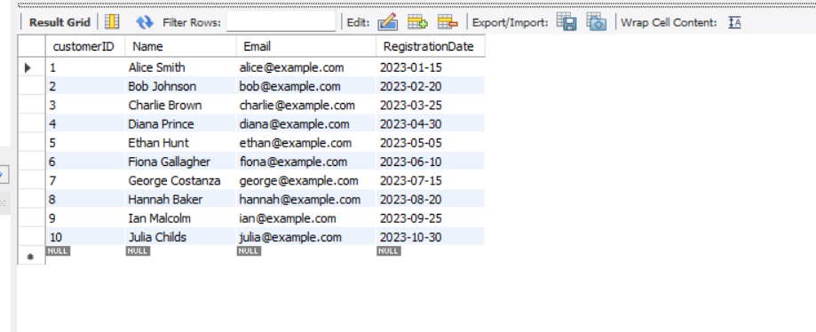
Insert at least 10 records into each table to populate the database with sample data.
QUERY :
INSERT INTO customers (customerID, Name, Email, RegistrationDate) VALUES (1, 'Alice Smith', 'alice@example.com', '2023-01-15'),(2, 'Bob Johnson', 'bob@example.com', '2023-02-20'),(3, 'Charlie Brown', 'charlie@example.com', '2023-03-25'),(4, 'Diana Prince', 'diana@example.com', '2023-04-30'),(5, 'Ethan Hunt', 'ethan@example.com', '2023-05-05'),(6, 'Fiona Gallagher', 'fiona@example.com', '2023-06-10'),(7, 'George Costanza', 'george@example.com', '2023-07-15'),(8, 'Hannah Baker', 'hannah@example.com', '2023-08-20'),(9, 'Ian Malcolm', 'ian@example.com', '2023-09-25'),(10, 'Julia Childs', 'julia@example.com', '2023-10-30’);
Result :

Slide 6
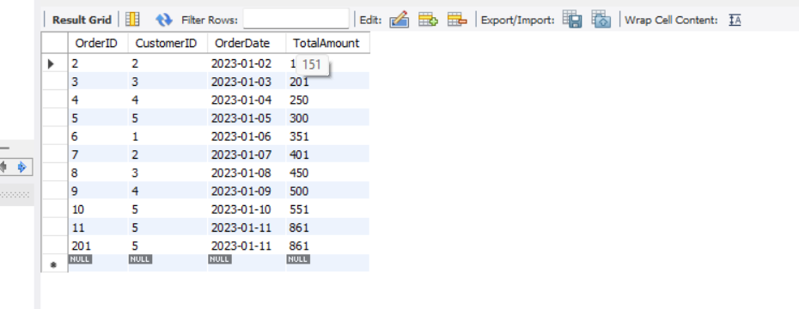
Write a query to select all details from the Orders table where the TotalAmount is greater than $100.
Query :
SELECT * FROM Orders WHERE TotalAmount > 100;
Result :

Slide 7
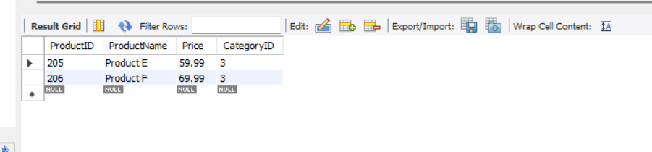
Write a query to select all products from the Products table where the Price is between $20 and $50 and the CategoryID is 3.
Query :
SELECT * FROM Products WHERE Price BETWEEN 20 AND 70 AND CategoryID = 3;
Result :

Slide 8
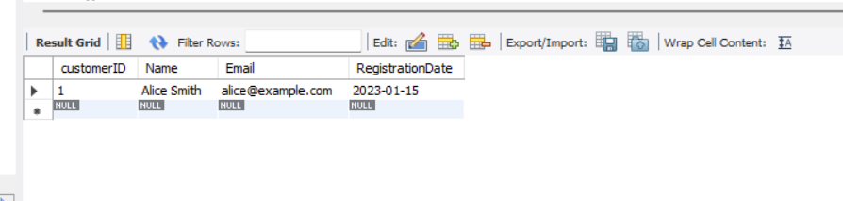
Write a query to select all customers whose Name starts with ‘A’.
Query :
SELECT * FROM Customers WHERE Name LIKE 'A%’;
Result :

Slide 9
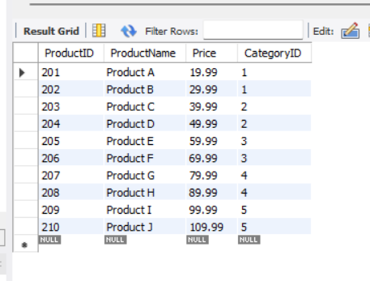
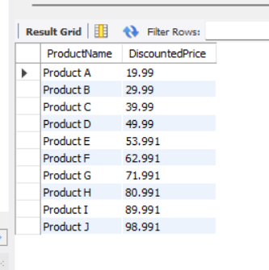
Write a query to select ProductName and a new column DiscountedPrice from the Products table. If Price is greater than $50, set DiscountedPrice to Price * 0.9, otherwise set it to Price.
Query :
SELECT ProductName, CASE WHEN Price > 50 THEN Price * 0.9 ELSE Price END AS DiscountedPriceFROM Products;
Result :
Product table
Updated Product table

Slide 10
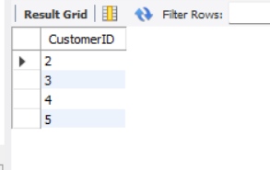
Write a query to find all customers who have placed orders totaling more than $500. Use a subquery to find these CustomerIDs.
Query :
SELECT CustomerID FROM Customers WHERE CustomerID IN (SELECT CustomerID FROM Orders GROUP BY CustomerID HAVING SUM(TotalAmount) > 500);
Result :

Slide 11
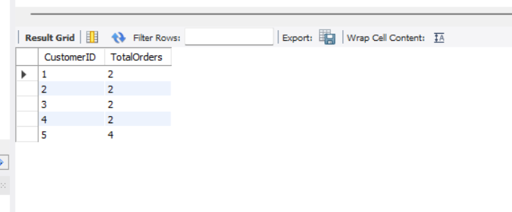
Write a query to get the total number of orders placed by each customer. Group the results by CustomerID and show the count of orders.
QUERY :
SELECT CustomerID, COUNT(OrderID) AS TotalOrdersFROM OrdersGROUP BY CustomerID;
Result :

Slide 12
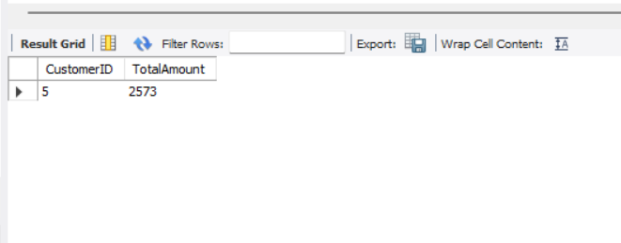
Write a query to get the total TotalAmount of orders placed by each customer, but only include customers who have placed more than 2 orders. Use the HAVING clause.
QUERY :
SELECT CustomerID, SUM(TotalAmount) AS TotalAmountFROM OrdersGROUP BY CustomerIDHAVING COUNT(OrderID) > 2;
Result :

Slide 13
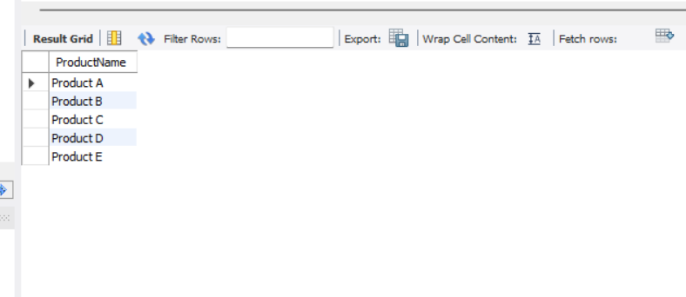
Write a query to select the first 5 products ordered by ProductName in ascending order
QUERY :
SELECT ProductName FROM Products ORDER BY ProductName ASC LIMIT 5;
Result :

Slide 14
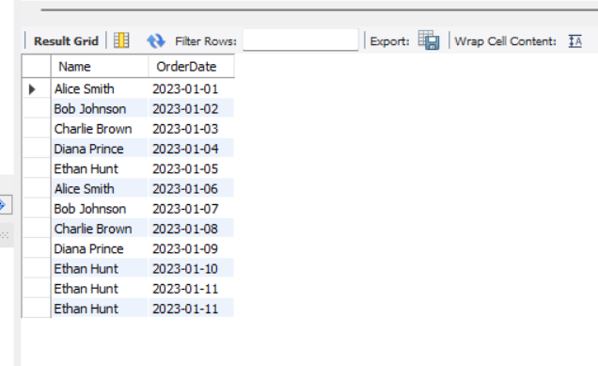
Write a query to join Orders with Customers to get a list of all orders with CustomerName and OrderDate
QUERY :
SELECT Customers.Name, Orders.OrderDateFROM OrdersINNER JOIN Customers ON Orders.CustomerID = Customers.CustomerID;
Result :

Slide 15
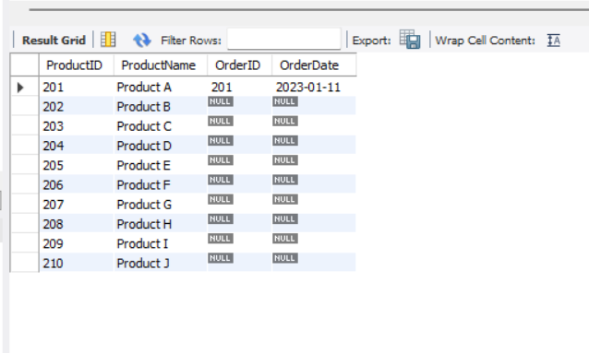
Write a query to get a list of all products and any associated order details. Include products that might not have been ordered.
QUERY :
SELECT p.ProductID, p.ProductName, o.OrderID, o.OrderDateFROM Products LEFT OUTER JOIN Orders o ON p.productID = o.OrderID;
Result : p.

Slide 16
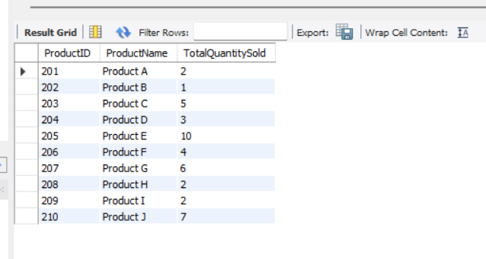
Write a query to get the total quantity of each product sold. Use an INNER JOIN between OrderDetails and Products, and group by ProductID.
QUERY :
SELECT p.ProductID, p.ProductName, SUM(od.Quantity) AS TotalQuantitySoldFROM OrderDetails odINNER JOIN Products p ON od.ProductID = p.ProductIDGROUP BY p.ProductID, p.ProductName;
Result :

Slide 17
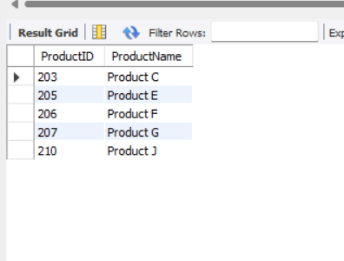
Write a query to find all products that were ordered more than the average quantity of all products. Use a subquery in the WHERE clause.
QUERY :
SELECT p.ProductID, p.ProductNameFROM Products p JOIN Orderdetails o ON p.ProductID = o.ProductIDWHERE o.Quantity > (SELECT AVG(Quantity) FROM Orderdetails);
Result :

Slide 18
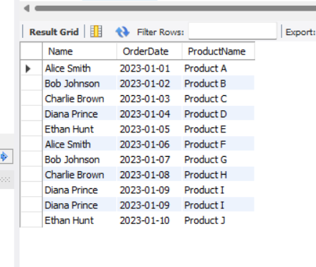
Write a query to list CustomerName, OrderDate, and ProductName for all orders. Use INNER JOIN and LEFT JOIN if necessary to get all required details.
QUERY :
SELECT c.Name, o.OrderDate, p.ProductNameFROM Customers cLEFT JOIN Orders o ON c.CustomerID = o.CustomerIDINNER JOIN OrderDetails od ON o.OrderID = od.OrderIDINNER JOIN Products p ON od.ProductID = p.ProductID;
Result :

Slide 19
THANK YOU

